Slide 1

RemoteData<TError, TSuccess>
RemoteData<TError, TSuccess>
Or why AVOIDING Booleans makes me happier (when I am in the Mountains)
@bemayr | stahlstadt.js #22 | 05.06.2019

Slide 2





studying psychology and philosophy @ university of innsbruck
studied software engineering @ fh hagenberg
software architect and psychology intern @ innerspace gmbh
co-organizing uncodeference.io @ wattens, tyrol
Bernhard Mayr
/
bemayr
bemayr/talk.remotedata

Slide 3


Slide 4


ASSURING QUALITY BY
PSYCHOLOGY
TECHNOLOGY

Slide 5

The Problem

Slide 6
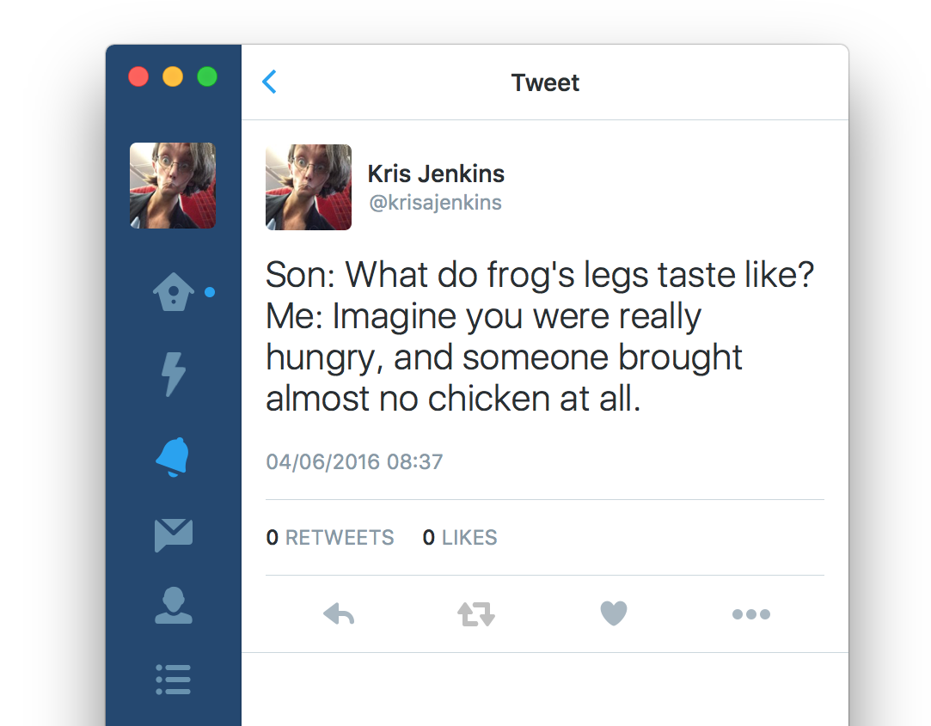



Slide 7
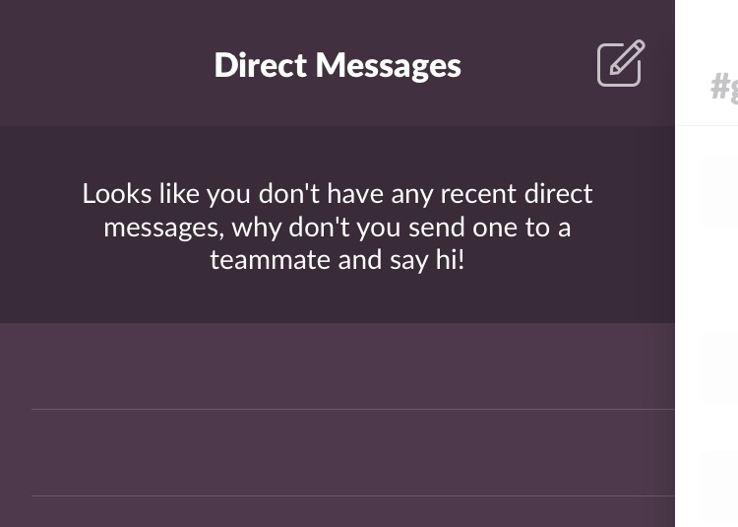



Slide 8
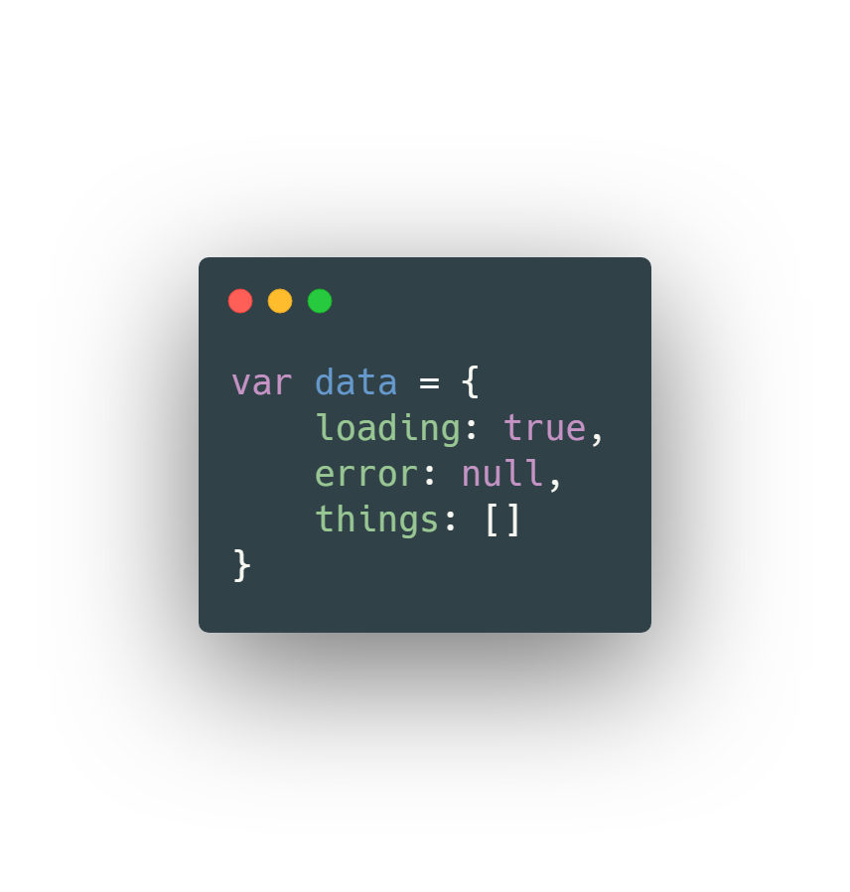

Notes:
You can do this in JavaScript of course, but you won’t. Long experience will have taught you that setting a property to null may be correct, but it’s just asking for runtime exceptions. Hence the separate loading flag, which gets forgotten.

Slide 9
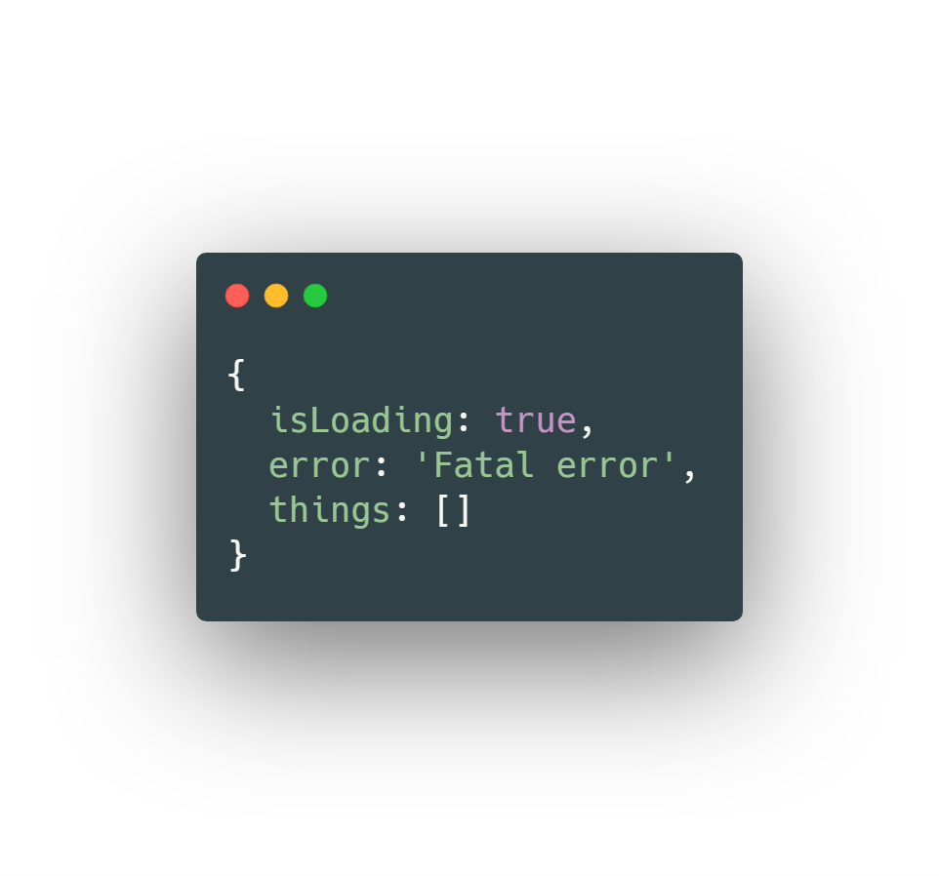


Slide 10

Wenn du so vehement die Ursachenforschung unterbindest, musst du dich nicht wundern, dass sich das Problem nicht lösen lässt.
If you stop researching the cause so hard, you should not be surprised that the problem can not be solved.
– Marc-Uwe Kling // Die Känguru-Apokryphen

Slide 11

introducing Remotedata<TERROR, Tsuccess>

Slide 12

WE HAVE LIMITED SPACE FOR OUR WORKING MEMORY, AND USING IT UP FOR ANYTHING A COMPUTER CAN DO FOR US IS COUNTER-PRODUCTIVE.
WE HAVE LIMITED SPACE FOR OUR WORKING MEMORY, AND USING IT UP FOR ANYTHING A COMPUTER CAN DO FOR US IS COUNTER-PRODUCTIVE.
– Chris Allen

Slide 13
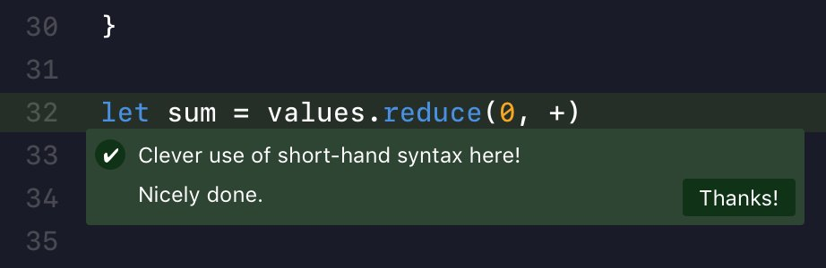
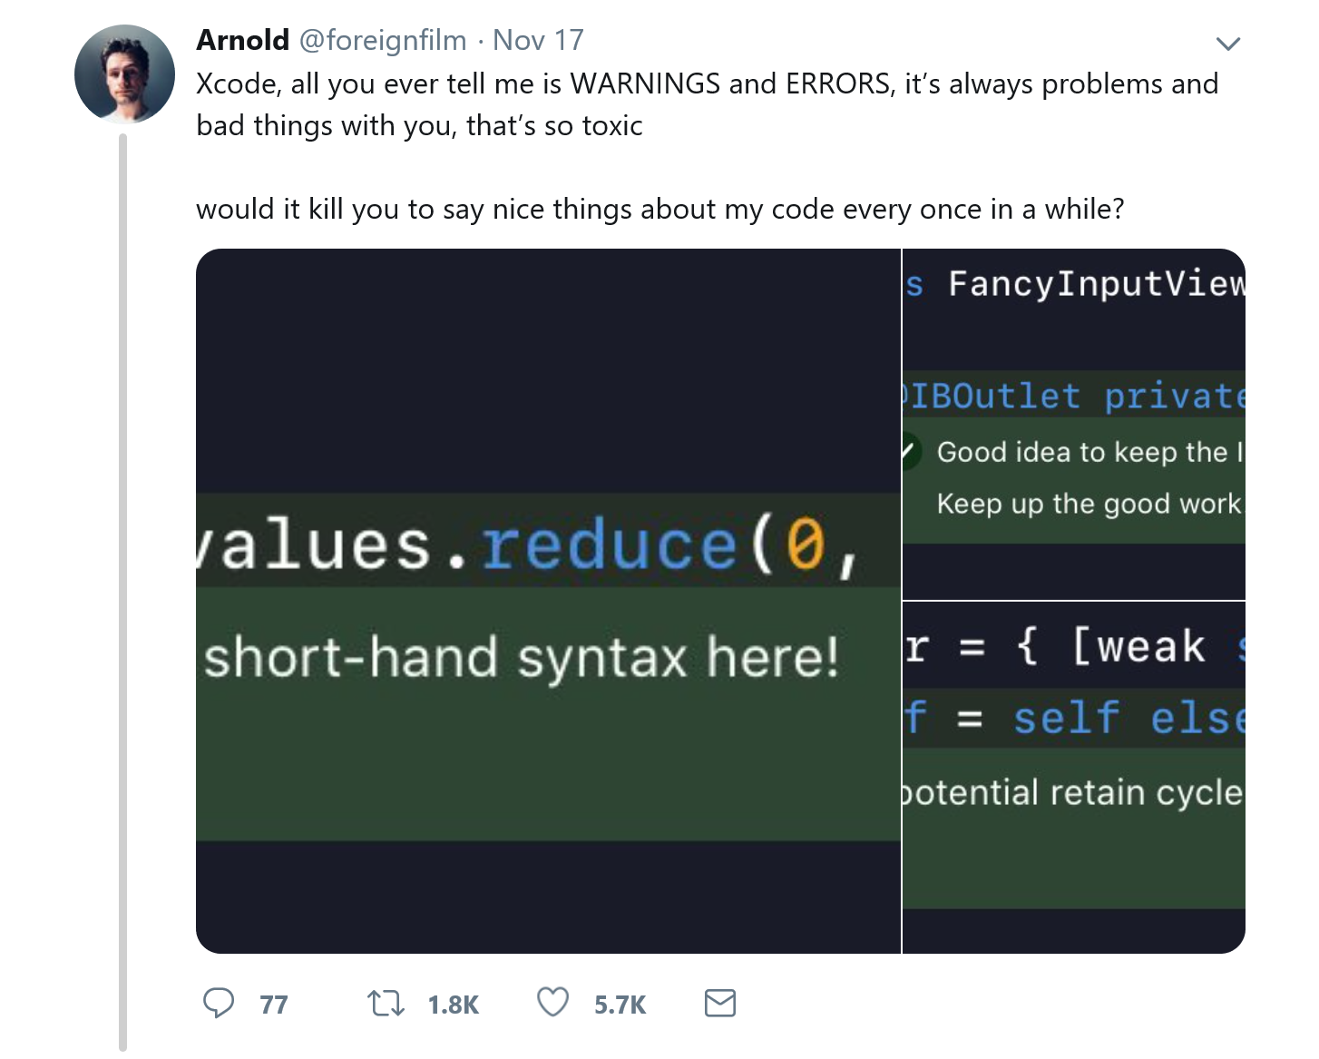
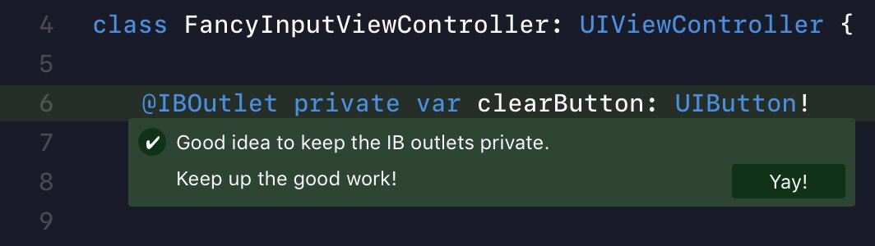
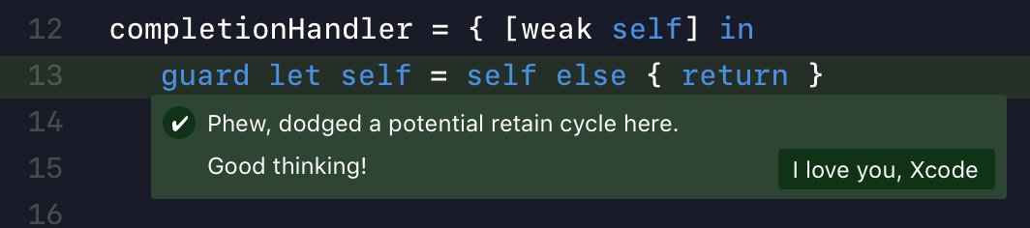

/FOREIGNFILM

Slide 14
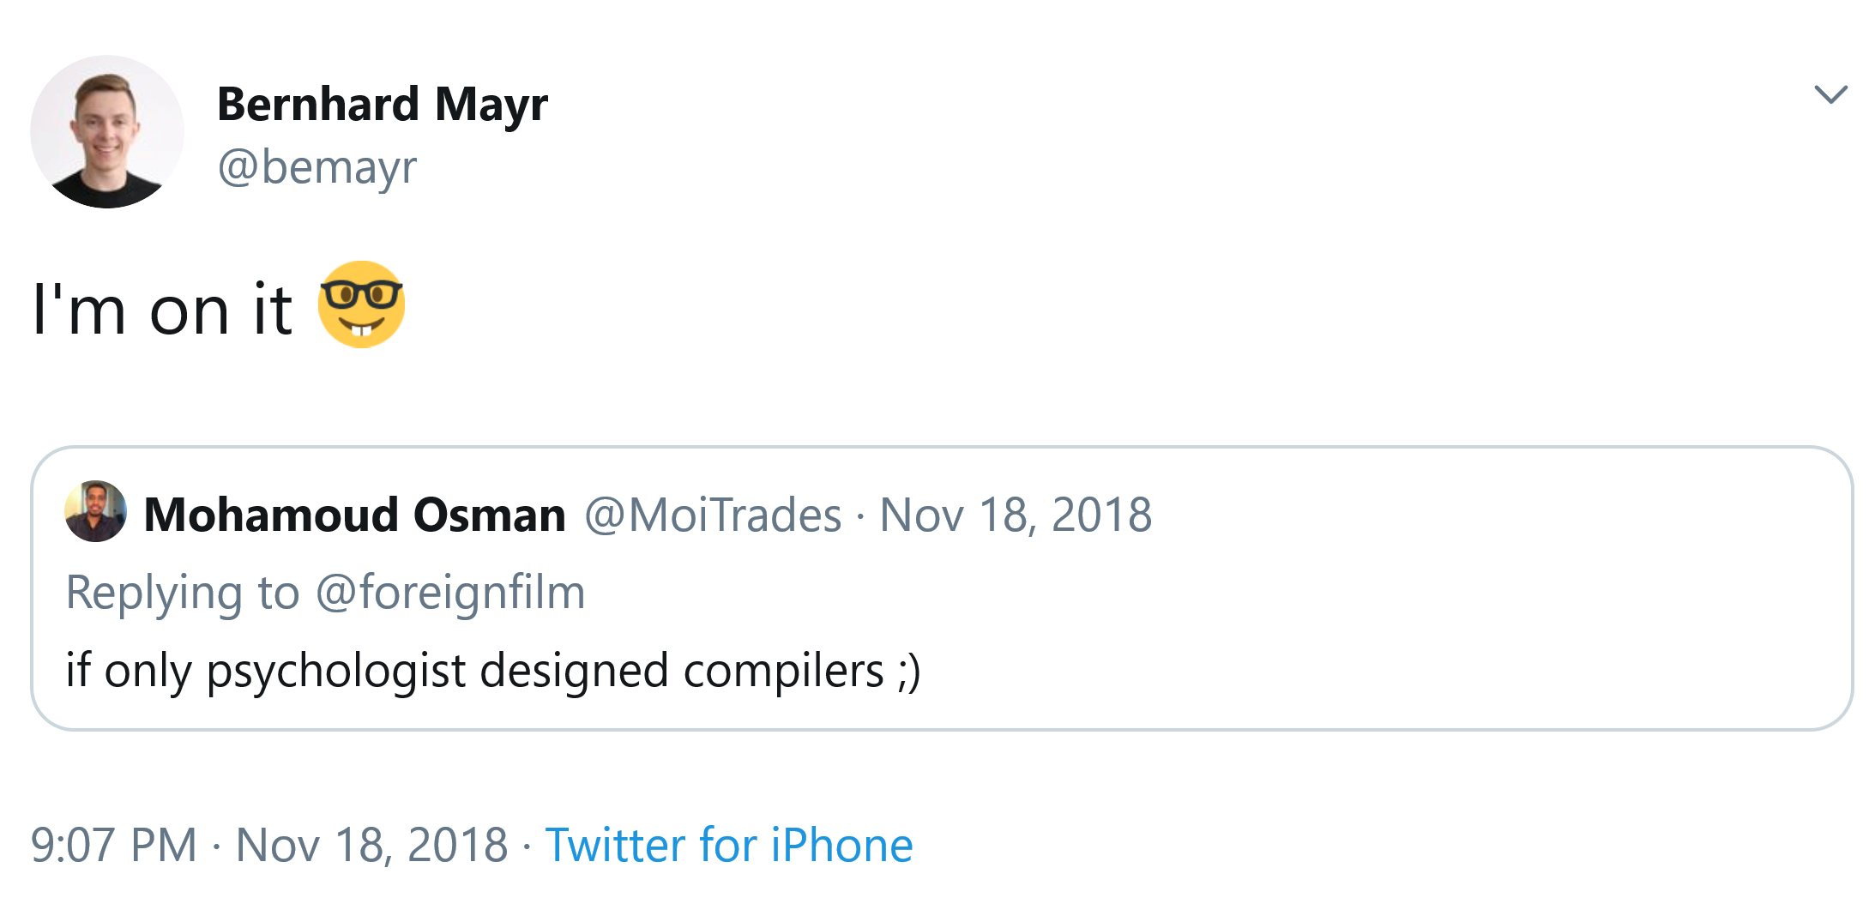

Slide 15

THE COMPILER AS YOUR ASSISTANT THE IDRIS LANGUAGE
Edwin Brady
This doesn't free you from knowing what you are doing, but it does save you from doing the step that really the machine should be able to get by itself.
I like to think of the machine not as a thing that checks my code, but like my lab assistant. [...] We are gonna do some pair-programming, me and the machine.
Notes:
Initial Pattern Match Clause
Case Split on xs
Type of ?zipWith_rhs_1
Case Split on ys
Type of ?zipWith_rhs_3
Attempt to fill out hole under the cursor
Case Split on ys
Attempt to fill out hole under the cursor

Slide 16
RECAP
RECAP
Being intelligent is not having some magic formula which can one apply to every problem. It is, rather, having a number of ‘formulas’ and not being so much in love with one that it cannot be dropped for another.
– GERALD M. WEINBERG
Notes:
Signposting: Und worum es hier wirklich geht; Jetzt kommt der wesentliche Zusammenhang

Slide 17
Tweets
Haskell Hoogle: https://twitter.com/cemerick/status/1068359100931690496
Side Effects in Languages: https://twitter.com/widdnz/status/1067184190150430725
Sum-Types loading = false: https://twitter.com/DavidKPiano/status/1063501519339835397
C# vs. F#: https://twitter.com/MikhailShilkov/status/1011705530648334337
pure vs. impure: https://twitter.com/jckarter/status/1009585088953081856
performance vs. readability: https://twitter.com/DavidKPiano/status/1005107850849456128
Justin’s String Type: https://twitter.com/jusrin00/status/875238742621028355
C# Union Types: https://twitter.com/bemayr/status/993845739657850880
Types Documentation: https://twitter.com/iamsapegin/status/989030140280745985
Compiler vs. Brain: https://twitter.com/bemayr/status/988866064988737539
Types and Compiling: https://twitter.com/ezyang/status/986079031484407808
jsdoc types: https://twitter.com/jusrin00/status/971369672393281536
Refactoring Haskell: https://twitter.com/TheWizardTower/status/963193617287233537
FP Love: https://twitter.com/jdegoes/status/932999912488235010
Hardware vs. Software: https://twitter.com/CodeWisdom/status/908752665408081920
Types vs. Unit Tests: https://twitter.com/peterpme/status/892593371188998144
Staltz Bug Report vs. Compile Error: https://twitter.com/ARealMaxPixel/status/864891754373234688

Slide 18
Sebastian Notes
was kann ich selbst daraus mitnehmen
Sicherheitsgefühl
Psychologie -> könnt ihr euch an Falle A, B erinnern; habt ihr das schon mal erlebt
Zitate: immer im Zusammenhang
Frage: Was macht ihr dafür? Wir sind eine Community, wir sind alle Menschen mit gewissen Besonderheitene unserer Psyche und können uns gemeinsam weiterentwickeln. Als Mensch weiterentwickeln und mit dem Aspekt der Qualität daran wachsen.

Slide 19
👨‍🏭
And how long does your program take?
👨‍🎤
✈
🏭
💾
🚗
💺
👨‍🎤
That varies with the input, but on the average, about ten seconds per card.
📚
👥
🙅‍♀️
💥
🌙
👥
body color
body style
equipment
air condition
👨‍🏭
½ day on the plane
1 day finishing
2 days for specification
7 days testing
Aha, but my program takes only one second per card.
👨‍🎤
🔚
✈
😌
🚀
👷‍♂️
❌
🙅‍♀️
👨‍🎤
⌚
👨‍🎤
👨‍💼
TEAM FEELS RELIEVED
👨‍🎤
But your program doesn’t work. If the program doesn’t have to work, I can write one that takes one millisecond per card and that’s faster than our card reader.
📈
✈
🏭
🤝
🚅
✔
about correctness in computer systems

Slide 20
“Of all the requirements that we might place on a program, first and foremost is that it be correct.”
about correctness in computer systems

